Slide 1
Enterprise-scale DBMS and SQL basics
Week 8
Dr. Farshid Keivanian

Slide 2
Week 8 Outline
Introduction
Enterprise-scale DBMS
Cloud Models (IaaS, PaaS, SaaS)
Provisioning Azure SQL
SQL Basics
Security in Azure – RBAC (Role-Based Access Control)
Week 8 Tutorial Activity (Step-by-Step)
Review & Reflection
Discussion & Role-Play Questions

Slide 3
Introduction
This week, we move from small-scale (like Access) to enterprise-scale databases (like SQL Server & Azure SQL).
Analogy: Think of Access like a family car (good for small trips), and Azure SQL like a train network (handles thousands of passengers daily).
By the end, you should:
Understand enterprise DBMS basics.
Provision a relational database in Azure.
Write simple SQL queries.

Slide 4
Enterprise-scale DBMS
Enterprise DBMS = handles very large data, many users, high security
Used in banks, airlines, hospitals, universities
MS Access → simple, desktop-based
Azure SQL → cloud-based, scalable

Slide 5
Enterprise-scale DBMS
Comparison Table
Feature | MS Access (Small-scale) | Azure SQL (Enterprise)
Data Size | Small (MBs–GBs) | Huge (TBs–PBs)
Users | 1–10 | 1000s
Security | Basic | Advanced (RBAC + encryption)
Cost | One-time | Subscription (monthly)
Example (Aus) | Café loyalty program | Qantas booking system

Slide 6
Enterprise-scale DBMS
Access DB: You’ll see the file size is small and usually only supports a handful of users.
Scaling to Woolworths: Problems would include slow performance, frequent crashes, limited security, and no ability to handle thousands of users or massive data.
Discussion point: Woolworths would never run on Access because it needs a system that can handle millions of transactions daily, strict security, and high availability — things only enterprise systems like Azure SQL or Oracle can provide.

Slide 7
Cloud Models (IaaS, PaaS, SaaS)
IaaS, PaaS, SaaS – Simple Explanation
IaaS: You rent a server. You manage everything yourself.
PaaS: You get a managed platform. Example: Azure SQL (Microsoft handles backups & security).
SaaS: Software delivered to you, ready to use. Example: Gmail, Office 365.

Slide 8
Cloud Models (IaaS, PaaS, SaaS)
IaaS = Infrastructure as a Service
PaaS = Platform as a Service
SaaS = Software as a Service

Slide 9
Cloud Models (IaaS, PaaS, SaaS)
IaaS (Infrastructure as a Service)
You rent the basic building blocks (servers, storage, network) You control almost everything
You manage: OS, apps, data
Provider manages: hardware
Think: “I get the computer, I do the rest”

Slide 10
Cloud Models (IaaS, PaaS, SaaS)
PaaS (Platform as a Service)
You get a ready-made environment to build/run apps
You manage: your app + data
Provider manages: OS, runtime, updates
Think: “I just build my app”

Slide 11
Cloud Models (IaaS, PaaS, SaaS)
SaaS (Software as a Service)
You just use the software
You manage: nothing technical
Provider manages: everything
Think: “I just use it”

Slide 12
Cloud Models (IaaS, PaaS, SaaS)
Easy memory trick
IaaS → Infrastructure → lowest level
PaaS → Platform → middle
SaaS → Software → highest (user level)

Slide 13
Cloud Models (IaaS, PaaS, SaaS)
IaaS = control everything PaaS = build apps only SaaS = just use the software

Slide 14
Cloud Models (IaaS, PaaS, SaaS)
Analogy
IaaS = renting a block of land & building your own house.
PaaS = renting an apartment with services included.
SaaS = Airbnb – just move in and use it, no management.

Slide 15
Cloud Models (IaaS, PaaS, SaaS)
Discussion Question)
Classify these: Office 365, Azure SQL, Google Drive → IaaS, PaaS, SaaS
Model Answer:
Office 365 → SaaS (ready-to-use software)
Azure SQL → PaaS (managed database platform)
Google Drive → SaaS (software/storage service you just use)

Slide 16
Provisioning Azure SQL
Provisioning = setting up a cloud service.
Azure SQL steps (overview):
Choose subscription (student/edu).
Pick/create a resource group.
Database name = StudentIDName.
Admin login + password.
Region = Australia East (Sydney).
Example
DB Name: A00127870_SajanDB
Resource Group: StudentRG2025

Slide 17
SQL Basics
SQL = Structured Query Language
The common language all databases understand.
You use it to ask for information.
Example Queries
SELECT * FROM Customers; → shows all details of all customers.
SELECT FirstName, LastName FROM Employees WHERE Department='IT'; → shows only names of employees in IT.

Slide 18
SQL Basics
Analogy SQL is like ordering food in a restaurant:
You ask (query) → “I want a pizza.”
The kitchen (database) prepares and delivers your order.

Slide 19
Security in Azure – RBAC (Role-Based Access Control)
Security Principal = Who → e.g., user, student, staff
Role = What they can do → read, write, delete
Scope = Where → database, table, or resource
Example A bank teller can view customer accounts but cannot change system passwords.

Slide 20
Security in Azure – RBAC (Role-Based Access Control)
Hands-on Debate Question: Should students have full admin rights on Uni DBs?
Answer: No — giving students full admin rights is risky. They might:
Accidentally delete or change important data
Access private information
Cause security or system issues

Slide 21
Security in Azure – RBAC (Role-Based Access Control)
Better approach:
Students should only get the role and scope they need (e.g., read-only access for learning).
Admin rights stay with IT staff to keep the system safe.

Slide 22
Week 8 Tutorial Activity (Step-by-Step)
Week 8+ uses Virtual Lab in browser, no install needed.
Topic: Exploring Azure SQL Database
Focus: How to create (provision), secure, and query a cloud database

Slide 23
Week 8 Tutorial Activity (Step-by-Step)
Why important?
Real-world companies use cloud DBs (banks, airlines, supermarkets)
Same SQL language works in Access and Azure
Learn how to scale from small desktop DBs → enterprise cloud systems

Slide 24
Week 8 Tutorial Activity (Step-by-Step)
Learning Goals for Week 8
Understand how to provision an Azure SQL Database
Practice SQL queries in the cloud
Compare Access vs Azure results
Apply security basics (RBAC roles & scope)
Analogy
Running queries in Access is like using a calculator. Running queries in Azure is like using a supercomputer that many people can share safely.

Slide 25
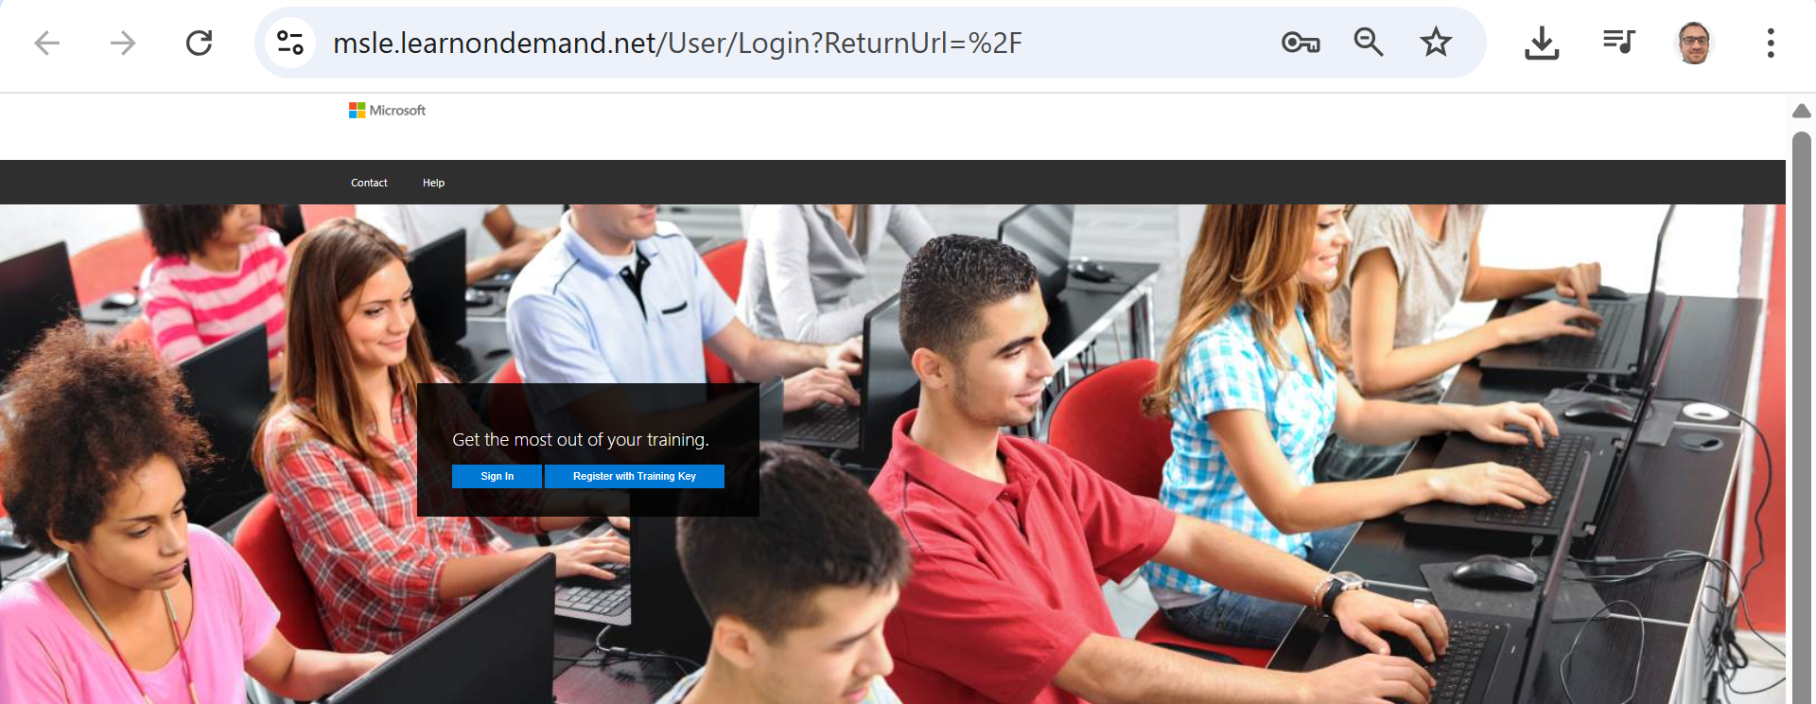
Week 8 Tutorial Activity (Step-by-Step)
Go to https://msle.learnondemand.net/
Open this page in your browser

Slide 26
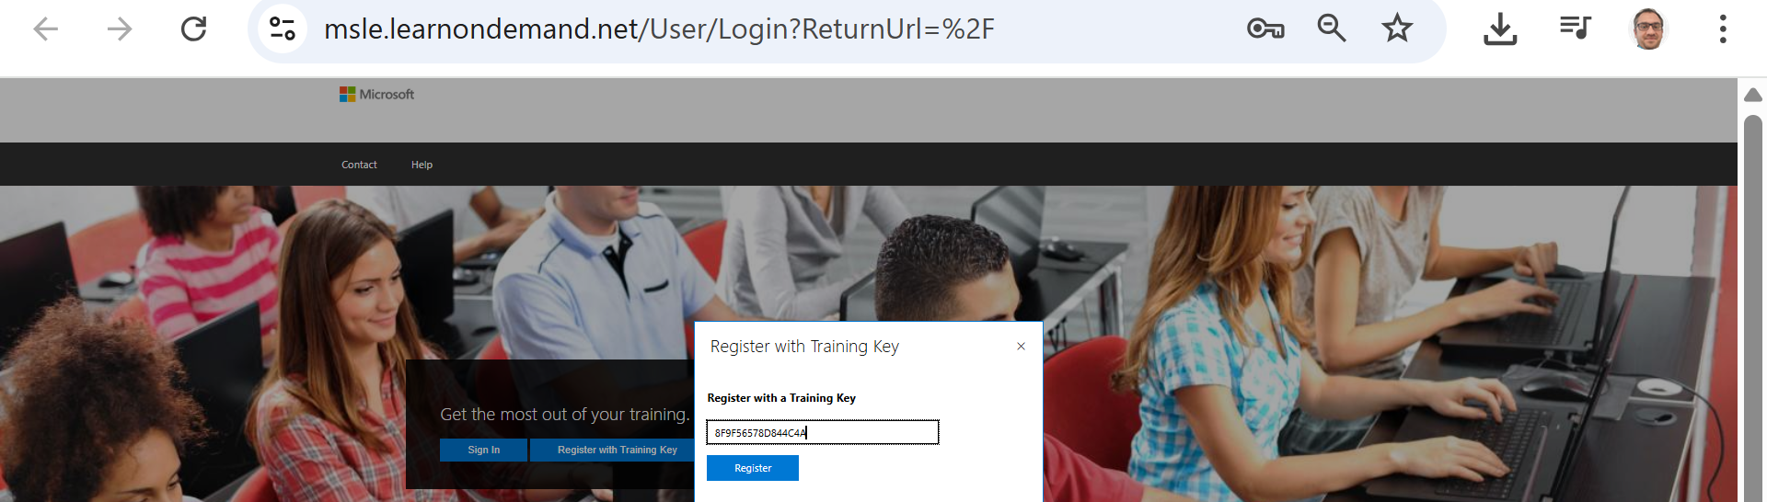
Week 8 Tutorial Activity (Step-by-Step)
Register with key: 39595D4F29DCCDC7
Open this page in your browser

Slide 27
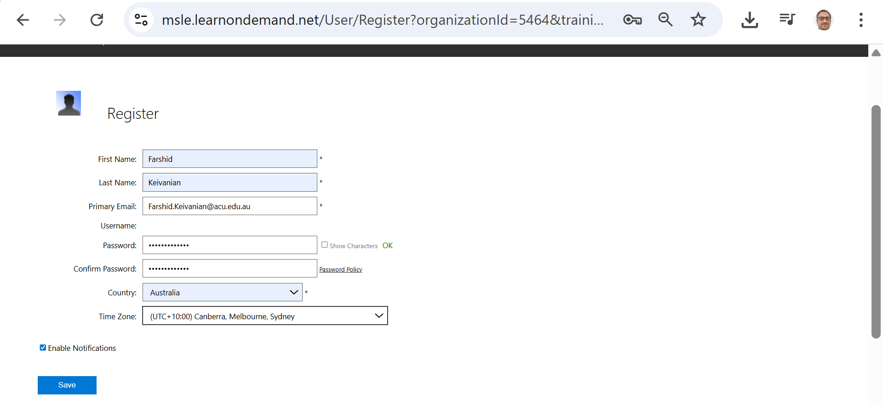
Week 8 Tutorial Activity (Step-by-Step)
Fill the form
Open this page in your browser

Slide 28
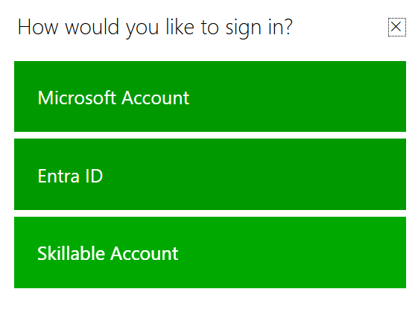
Week 8 Tutorial Activity (Step-by-Step)
If already registered and you want to log in
On the popup (as in your screenshot), choose Skillable Account.
Enter the username/email and password you created when you first registered with the key.
Once logged in, you’ll see your training dashboard → then launch Explore Azure SQL Database.

Slide 29
Week 8 Tutorial Activity (Step-by-Step)
If already registered and you want to log in
Don’t pick Microsoft Account or Entra ID unless your lab instructions specifically require it — those are for enterprise logins.

Slide 30
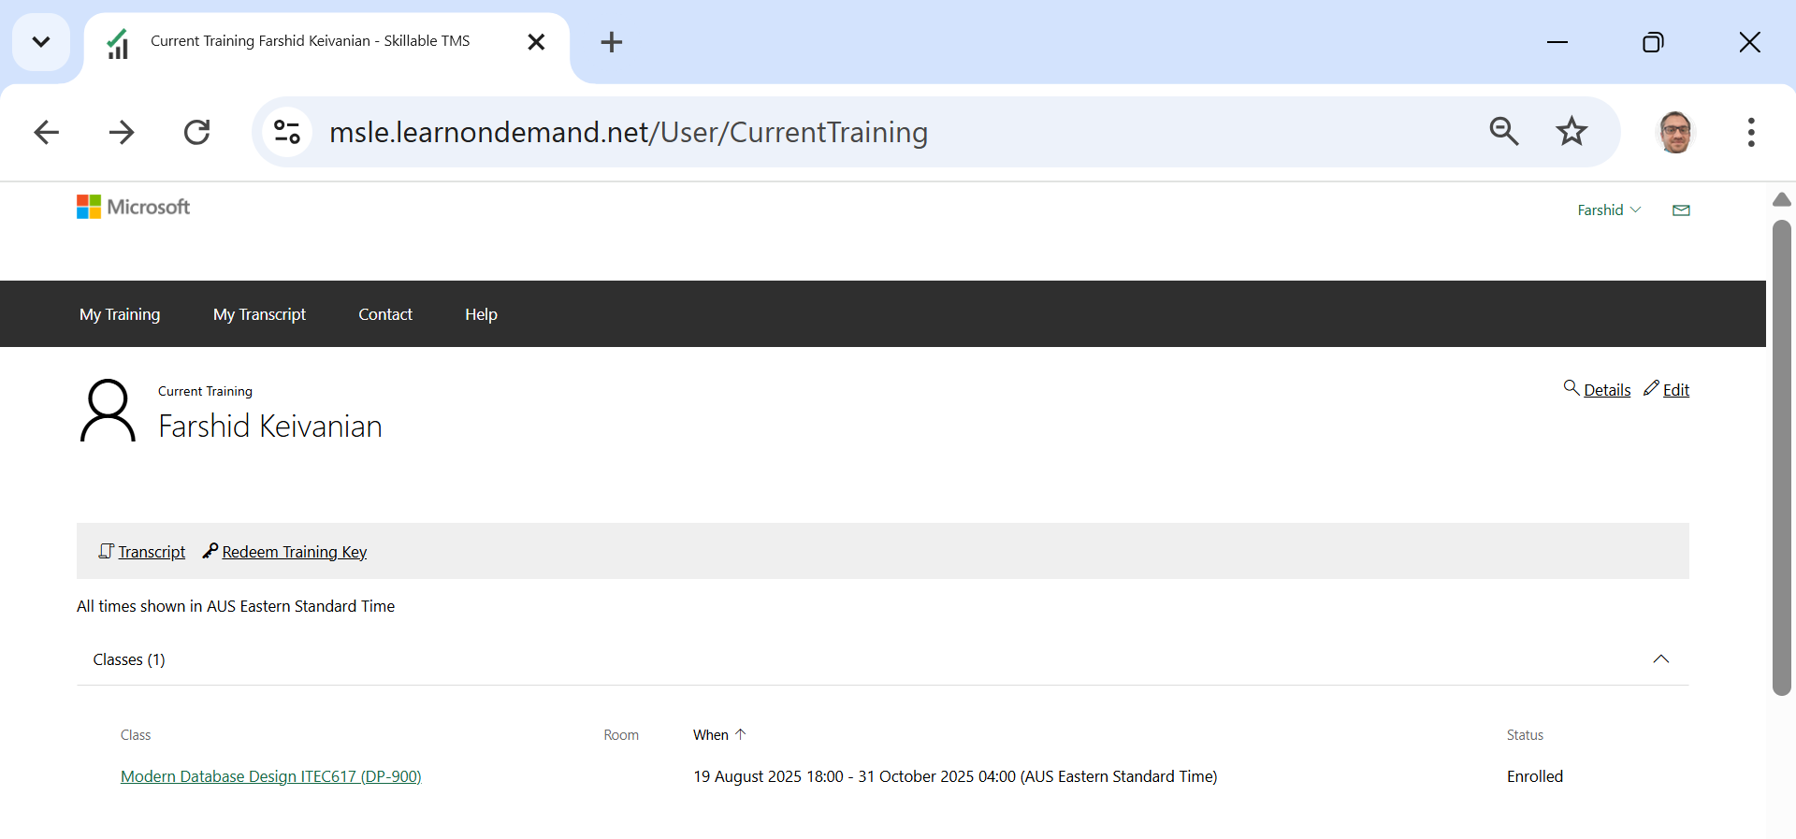
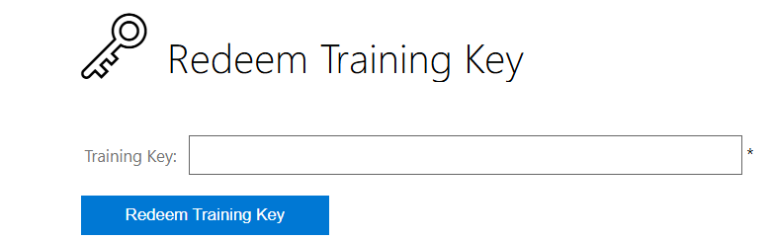
Week 8 Tutorial Activity (Step-by-Step)
If already registered and you want to log in
39595D4F29DCCDC7
Open this page in your browser

Slide 31
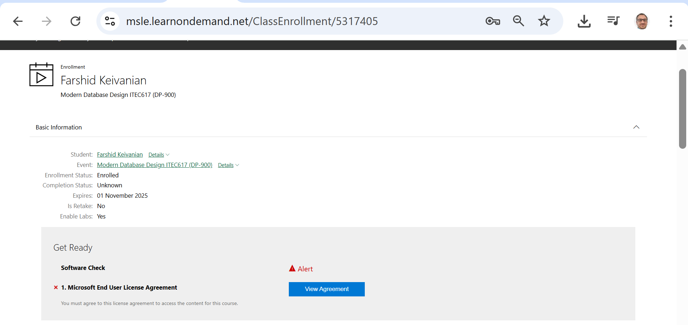
Week 8 Tutorial Activity (Step-by-Step)
View Agreement (either you just registered or logged in, you will see this page)
Open this page in your browser

Slide 32
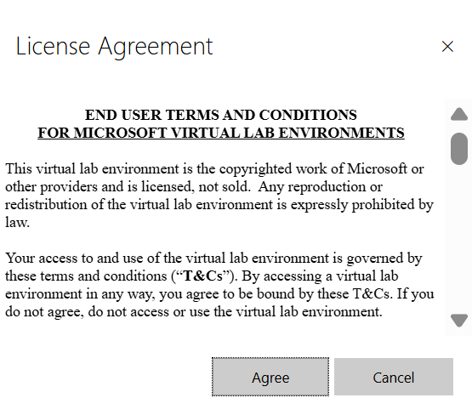
Week 8 Tutorial Activity (Step-by-Step)
Accept the license (Agree)

Slide 33
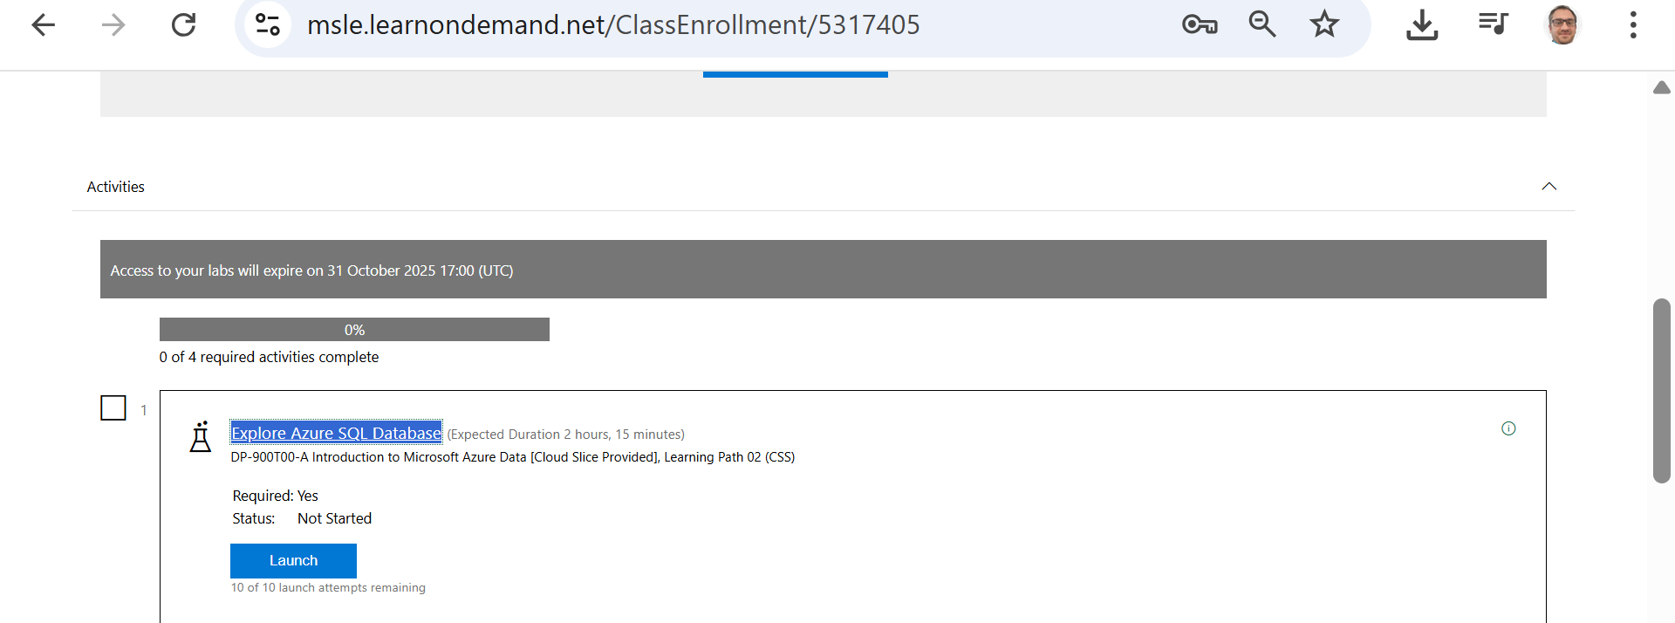
Week 8 Tutorial Activity (Step-by-Step)
Launch the lab “Explore Azure SQL Database”
Use the lab’s Azure username/password to sign in to the Azure Portal.
Click Start → Open Azure Portal and sign in with those credentials.

Slide 34
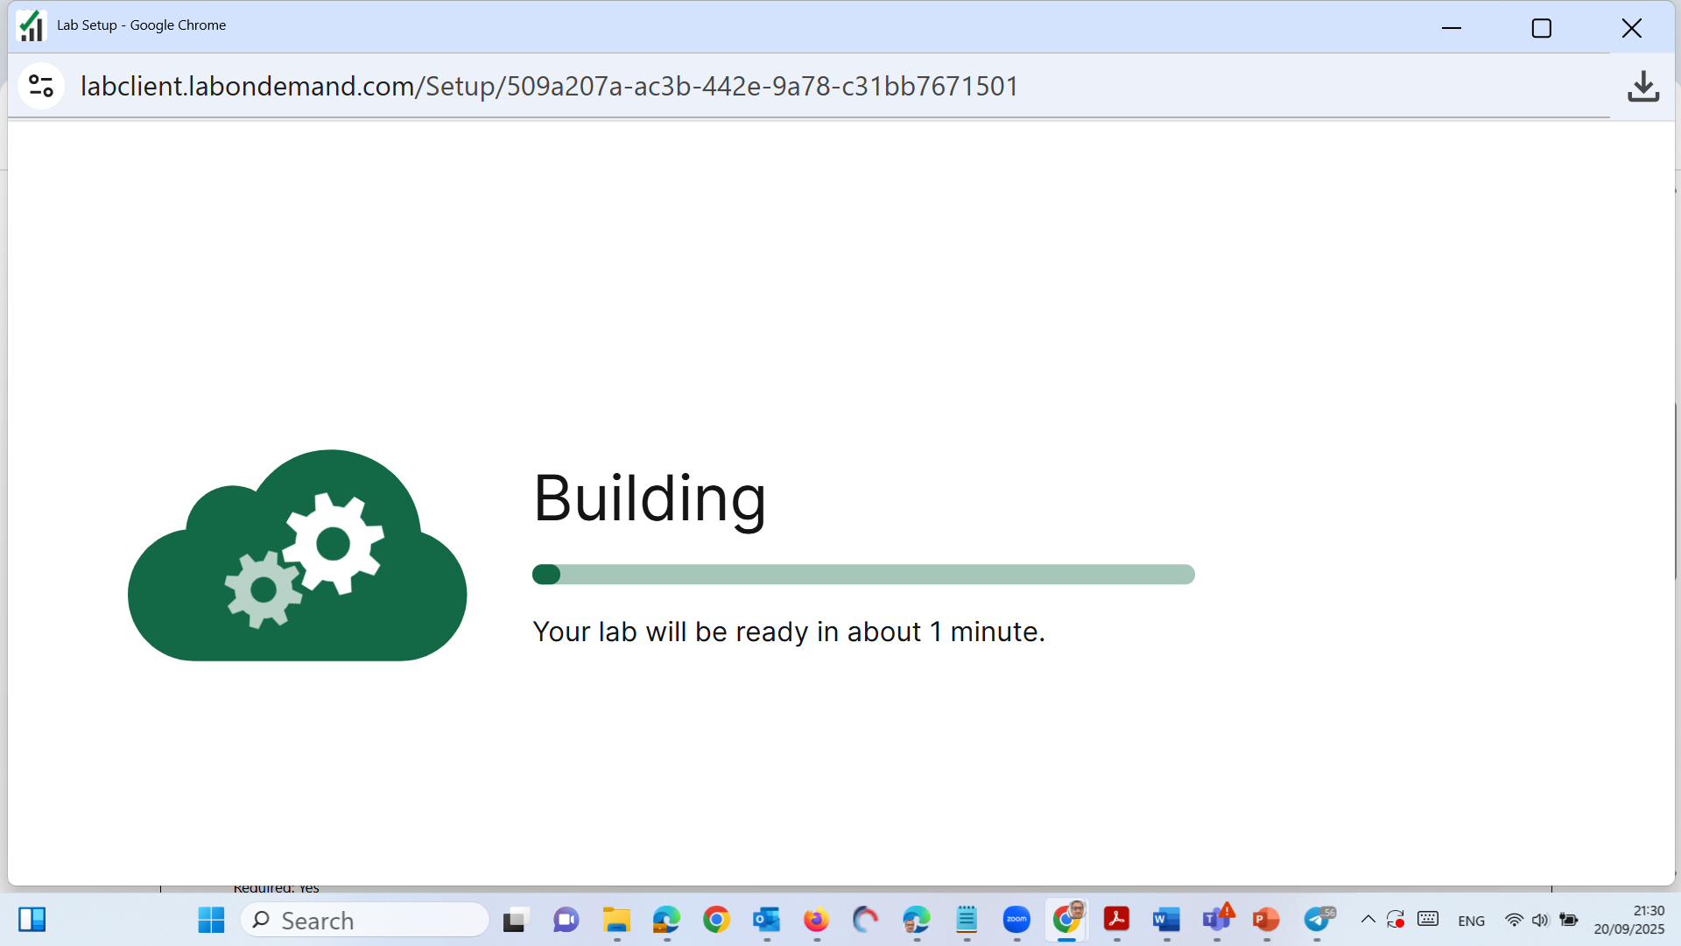
Week 8 Tutorial Activity (Step-by-Step)

Slide 35
Week 8 Tutorial Activity (Step-by-Step)
Important:
Follow the on-screen instructions in the right-hand side window of the virtual lab to log in and complete the tasks as instructed.

Slide 36
Week 8 Tutorial Activity (Step-by-Step)
Important: Do not open Azure Portal on your browser, instead run the virtual machine and then open the Azure Portal on the virtual machine’s browser

Slide 37
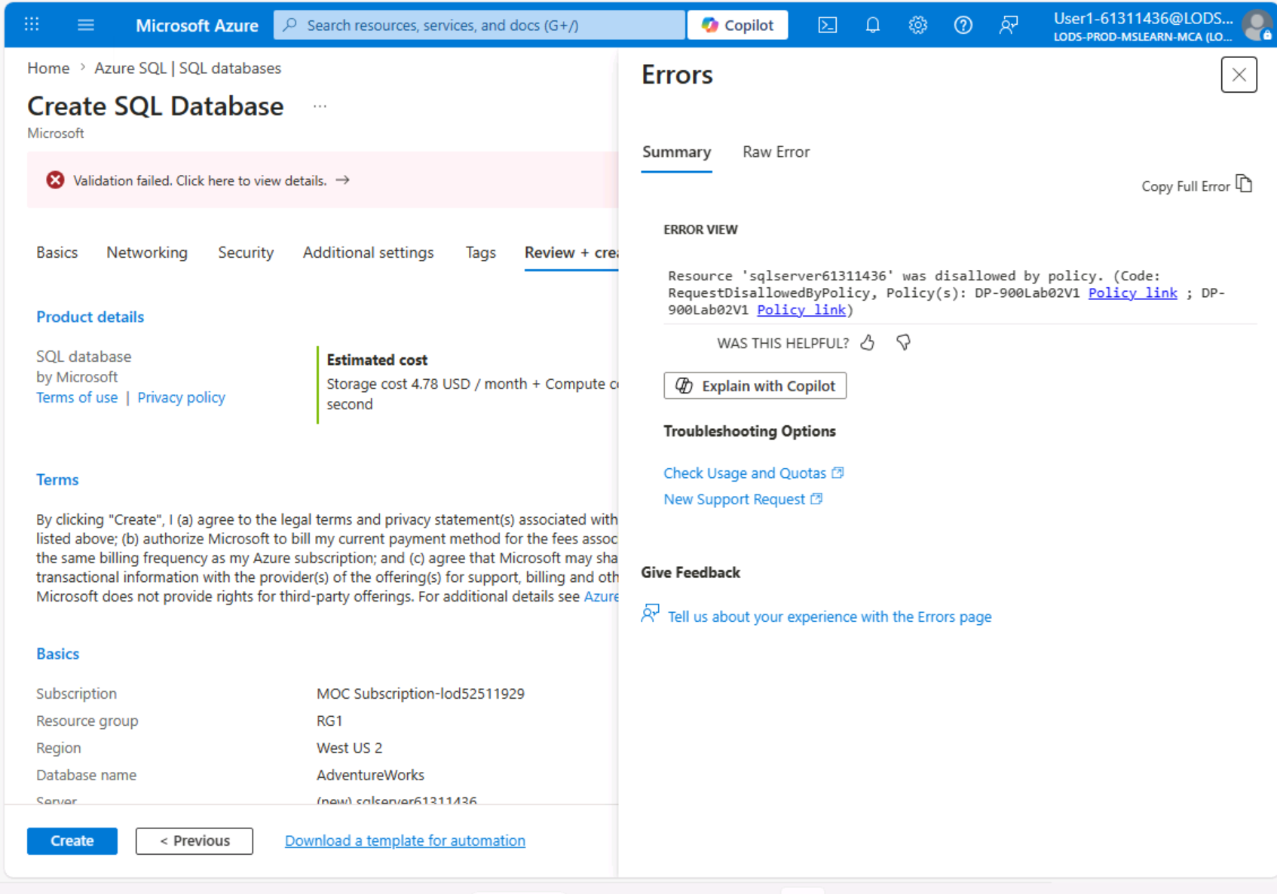
Week 8 Tutorial Activity (Step-by-Step)
Common Lab Issue: Azure Policy Validation Error

Slide 38
Week 8 Tutorial Activity (Step-by-Step)
What does it mean?
You are working in a controlled lab environment
Azure applies policies (rules) to restrict configurations
If settings don’t match lab requirements → validation fails

Slide 39
Week 8 Tutorial Activity (Step-by-Step)
Why this happens
Incorrect region (e.g., West US 2 instead of West US)
Wrong or random server name
Not using the required resource group (RG1)
Ignoring instructions on the right-hand lab panel

Slide 40
Week 8 Tutorial Activity (Step-by-Step)
How to fix it
✔ Use server name provided on the right side window
✔ Avoid double click on server name (only one click)
✔ Match region EXACTLY as shown in lab instructions
✔ Use RG1 as the resource group
✔ Follow lab panel settings (not defaults)
✔ If needed → go back and re-enter details or restart lab

Slide 41
Week 8 Tutorial Activity (Step-by-Step)
Key takeaway
Small configuration differences in cloud environments can cause errors — Always follow lab instructions exactly.
“This is not a mistake — it’s how real cloud systems enforce security and consistency.”

Slide 42
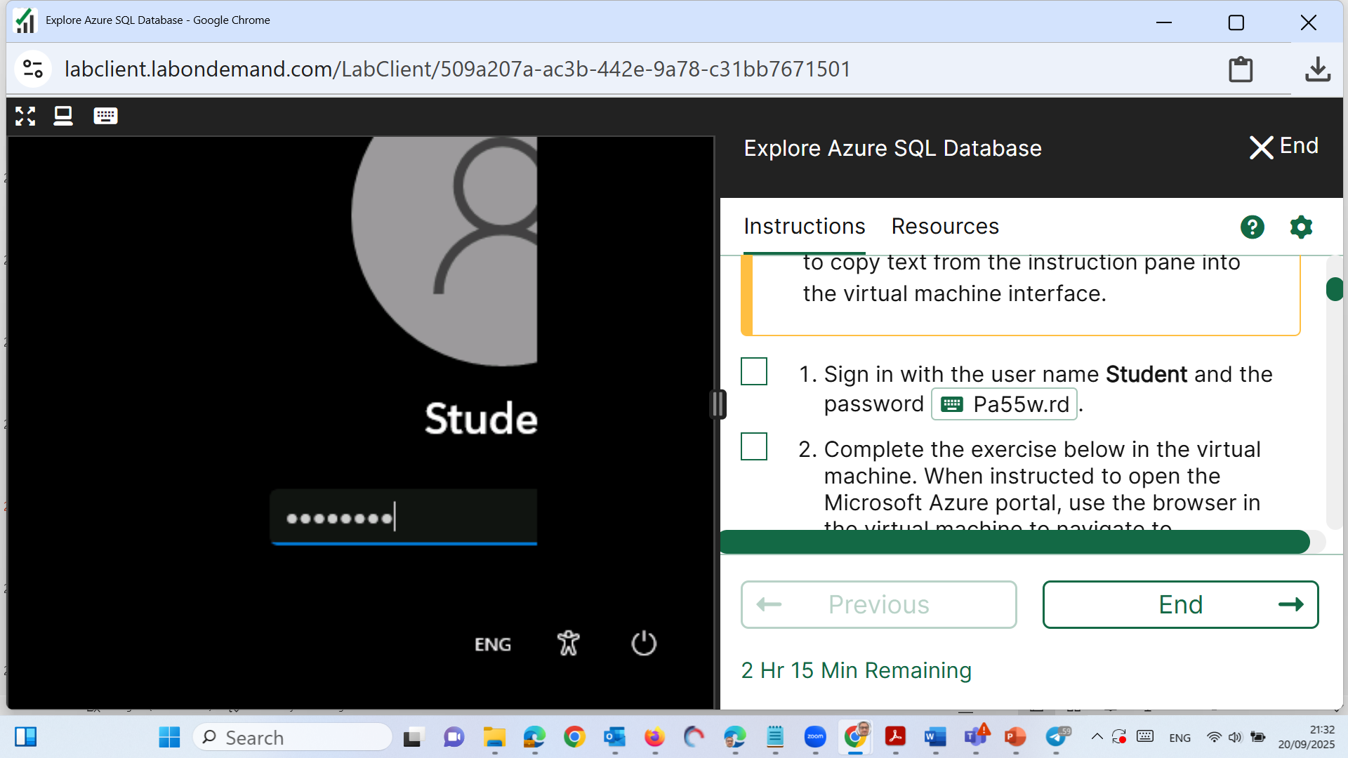
Week 8 Tutorial Activity (Step-by-Step)
Click on Password and Press Enter
Important: Do not open Azure Portal on your browser, instead run the virtual machine and then open the Azure Portal on the virtual machine’s browser

Slide 43
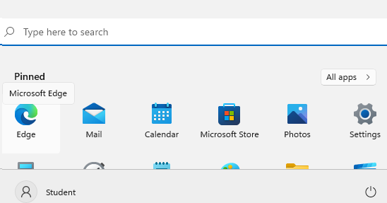
Week 8 Tutorial Activity (Step-by-Step)
Click Start and Go to Edge Browser
Important: Do not open Azure Portal on your browser, instead run the virtual machine and then open the Azure Portal on the virtual machine’s browser

Slide 44
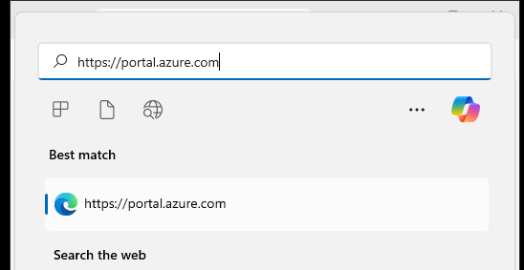
Week 8 Tutorial Activity (Step-by-Step)
Click on Website (Portal); it is on right sidebar
You will see this
Important: Do not open Azure Portal on your browser, instead run the virtual machine and then open the Azure Portal on the virtual machine’s browser

Slide 45
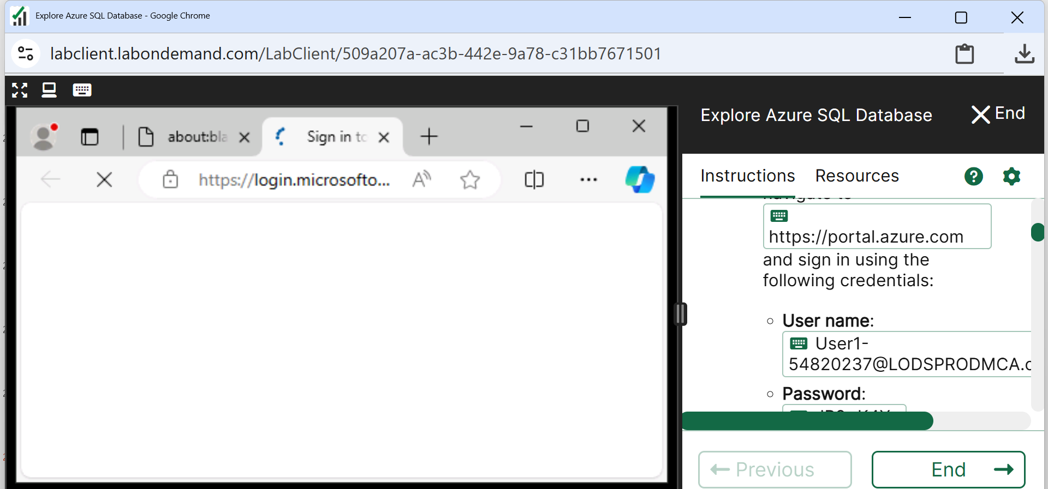
Week 8 Tutorial Activity (Step-by-Step)
Press Enter; you will see this page
Important: Do not open Azure Portal on your browser, instead run the virtual machine and then open the Azure Portal on the virtual machine’s browser

Slide 46
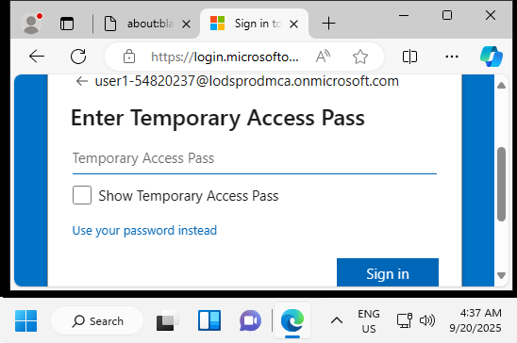
Week 8 Tutorial Activity (Step-by-Step)
Click on User and Pass (on right sidebar) to log in
Important: Do not open Azure Portal on your browser, instead run the virtual machine and then open the Azure Portal on the virtual machine’s browser

Slide 47
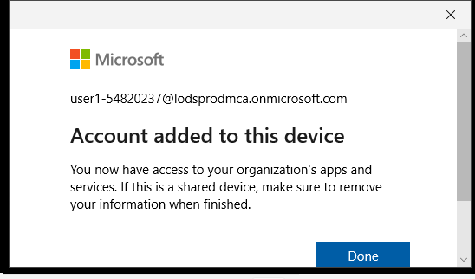
Week 8 Tutorial Activity (Step-by-Step)
Click Yes then you see this
Important: Do not open Azure Portal on your browser, instead run the virtual machine and then open the Azure Portal on the virtual machine’s browser

Slide 48
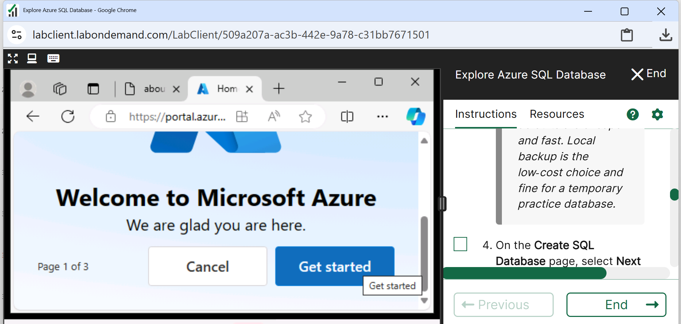
Week 8 Tutorial Activity (Step-by-Step)
Cancel this for now
Important: Do not open Azure Portal on your browser, instead run the virtual machine and then open the Azure Portal on the virtual machine’s browser

Slide 49
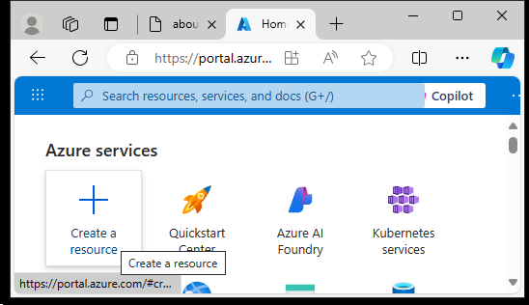
Week 8 Tutorial Activity (Step-by-Step)
Click Create a Resource
Important: Do not open Azure Portal on your browser, instead run the virtual machine and then open the Azure Portal on the virtual machine’s browser

Slide 50
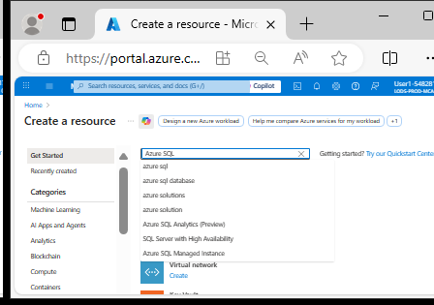
Week 8 Tutorial Activity (Step-by-Step)
Search for Azure SQL

Slide 51
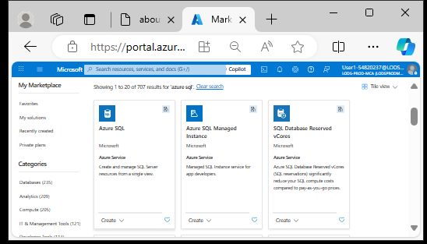
Week 8 Tutorial Activity (Step-by-Step)
Click Azure SQL

Slide 52
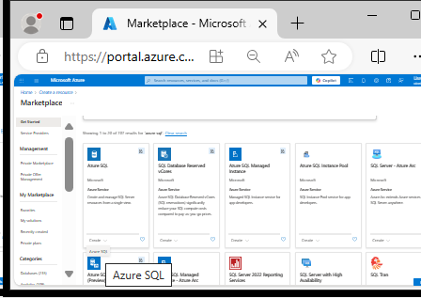
Week 8 Tutorial Activity (Step-by-Step)
Click Create

Slide 53
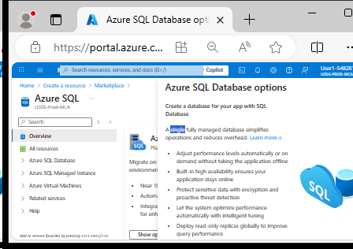
Week 8 Tutorial Activity (Step-by-Step)
Ensure it is single database

Slide 54
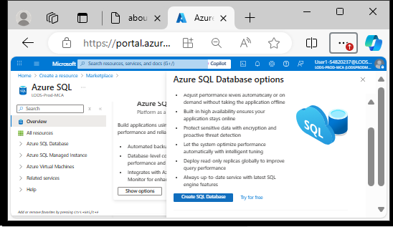
Week 8 Tutorial Activity (Step-by-Step)
Click Create SQL Database

Slide 55
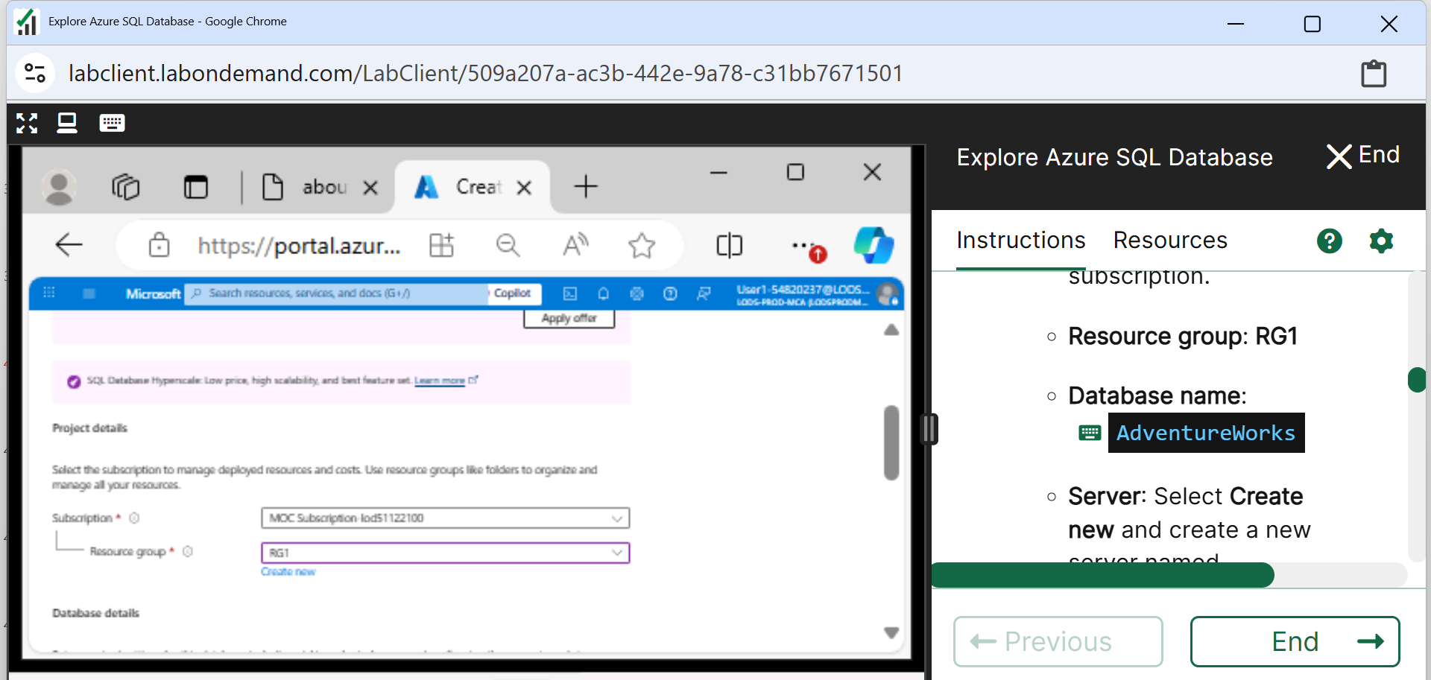
Week 8 Tutorial Activity (Step-by-Step)
Resource – Type: RG1

Slide 56
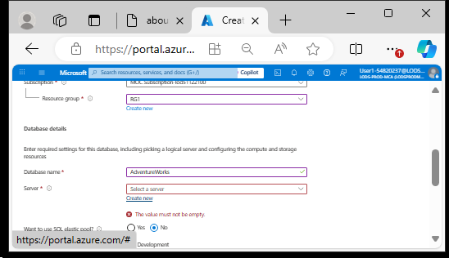
Week 8 Tutorial Activity (Step-by-Step)
In step 3, use your Student ID+name as the "database name". (I chose the default one)

Slide 57
Week 8 Tutorial Activity (Step-by-Step)
Server: Create new
Make sure to use the resource group/server name and region provided on the right-hand side window.

Slide 58
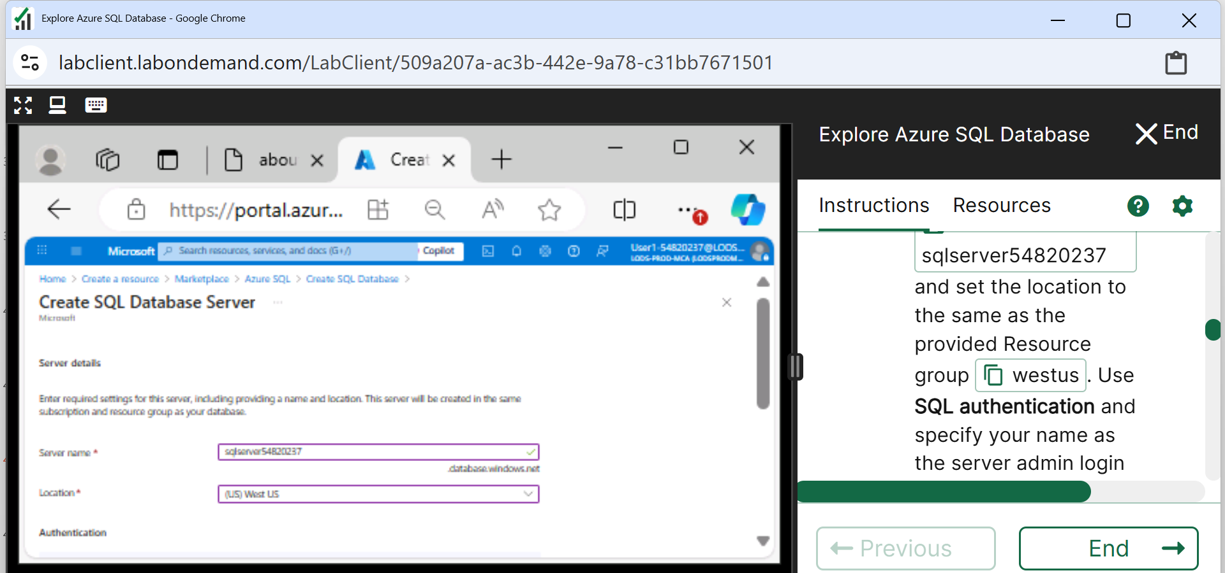
Week 8 Tutorial Activity (Step-by-Step)
For the location, scroll down to find (US) West US
Make sure to use the resource group/server name and region provided on the right-hand side window.

Slide 59
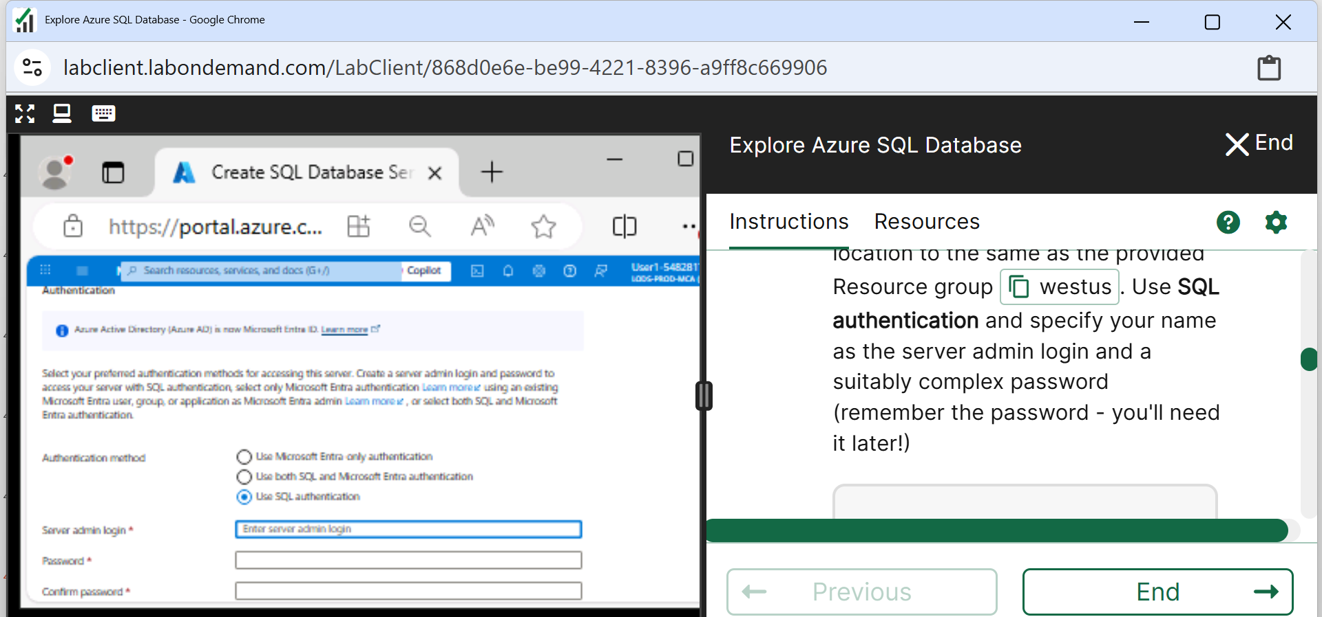
Week 8 Tutorial Activity (Step-by-Step)
Use SQL Authentication

Slide 60
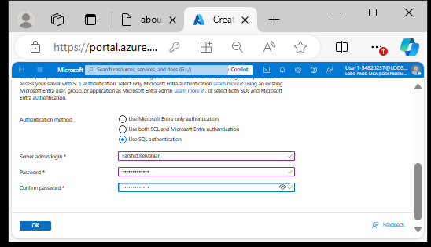
Week 8 Tutorial Activity (Step-by-Step)
Enter Your name as Server name and set a password (You will need it later) e.g., I typed Farshid.Keivanian
Click OK

Slide 61
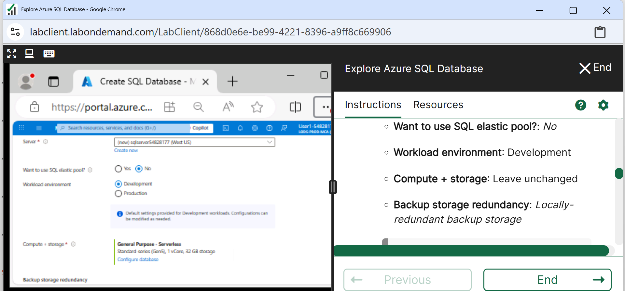
Week 8 Tutorial Activity (Step-by-Step)
Please follow the instructions on the right sidebar

Slide 62
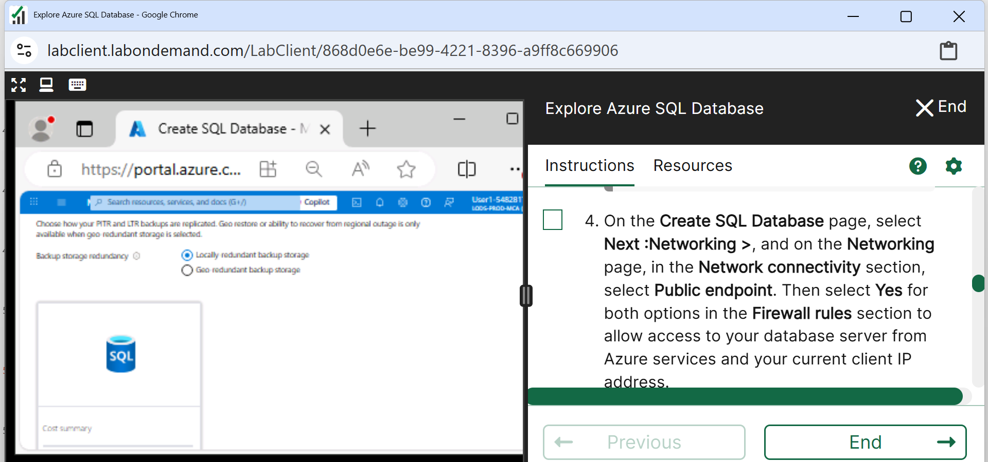
Week 8 Tutorial Activity (Step-by-Step)
Choose Locally-redundant backup storage

Slide 63
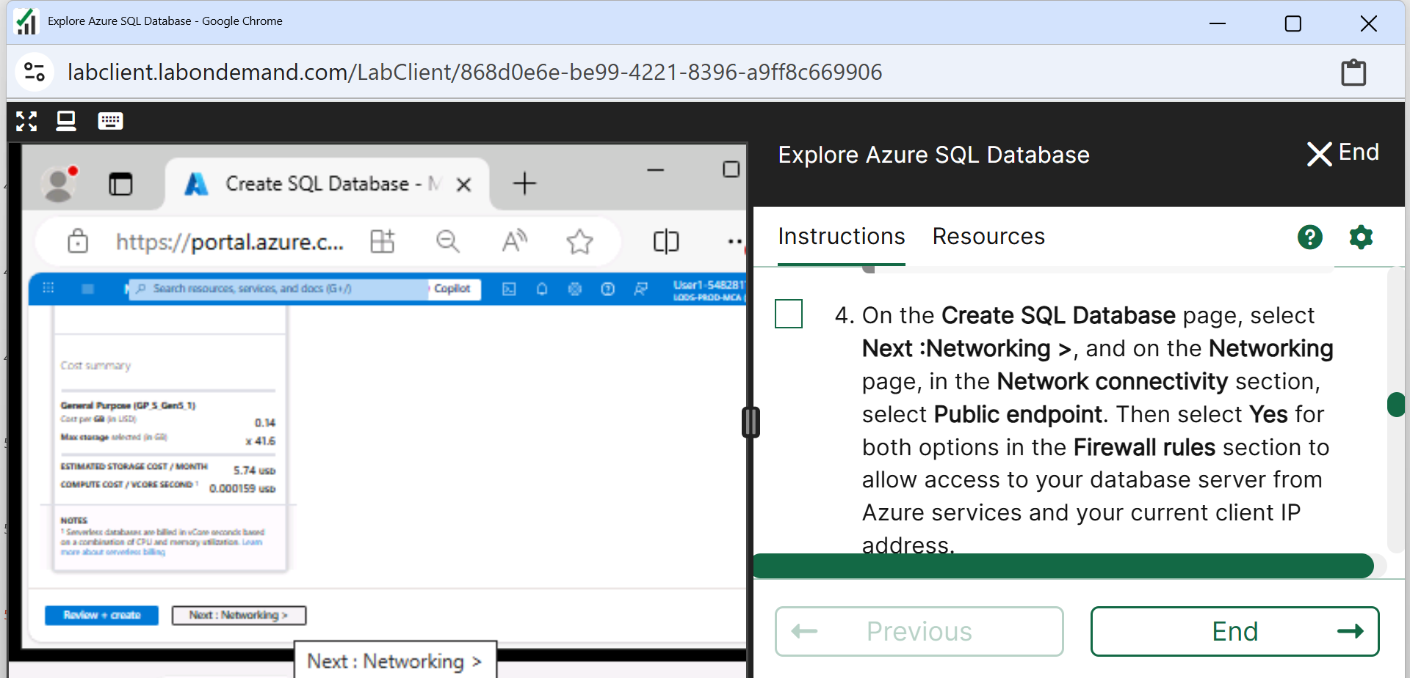
Week 8 Tutorial Activity (Step-by-Step)
Click Next: Networking

Slide 64
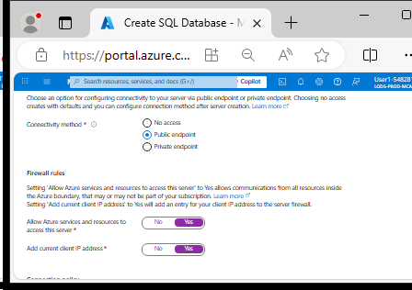
Week 8 Tutorial Activity (Step-by-Step)
Select Public endpoint, and Yes for both firewall options to allow access to your database server from Azure services and your current client IP address.

Slide 65
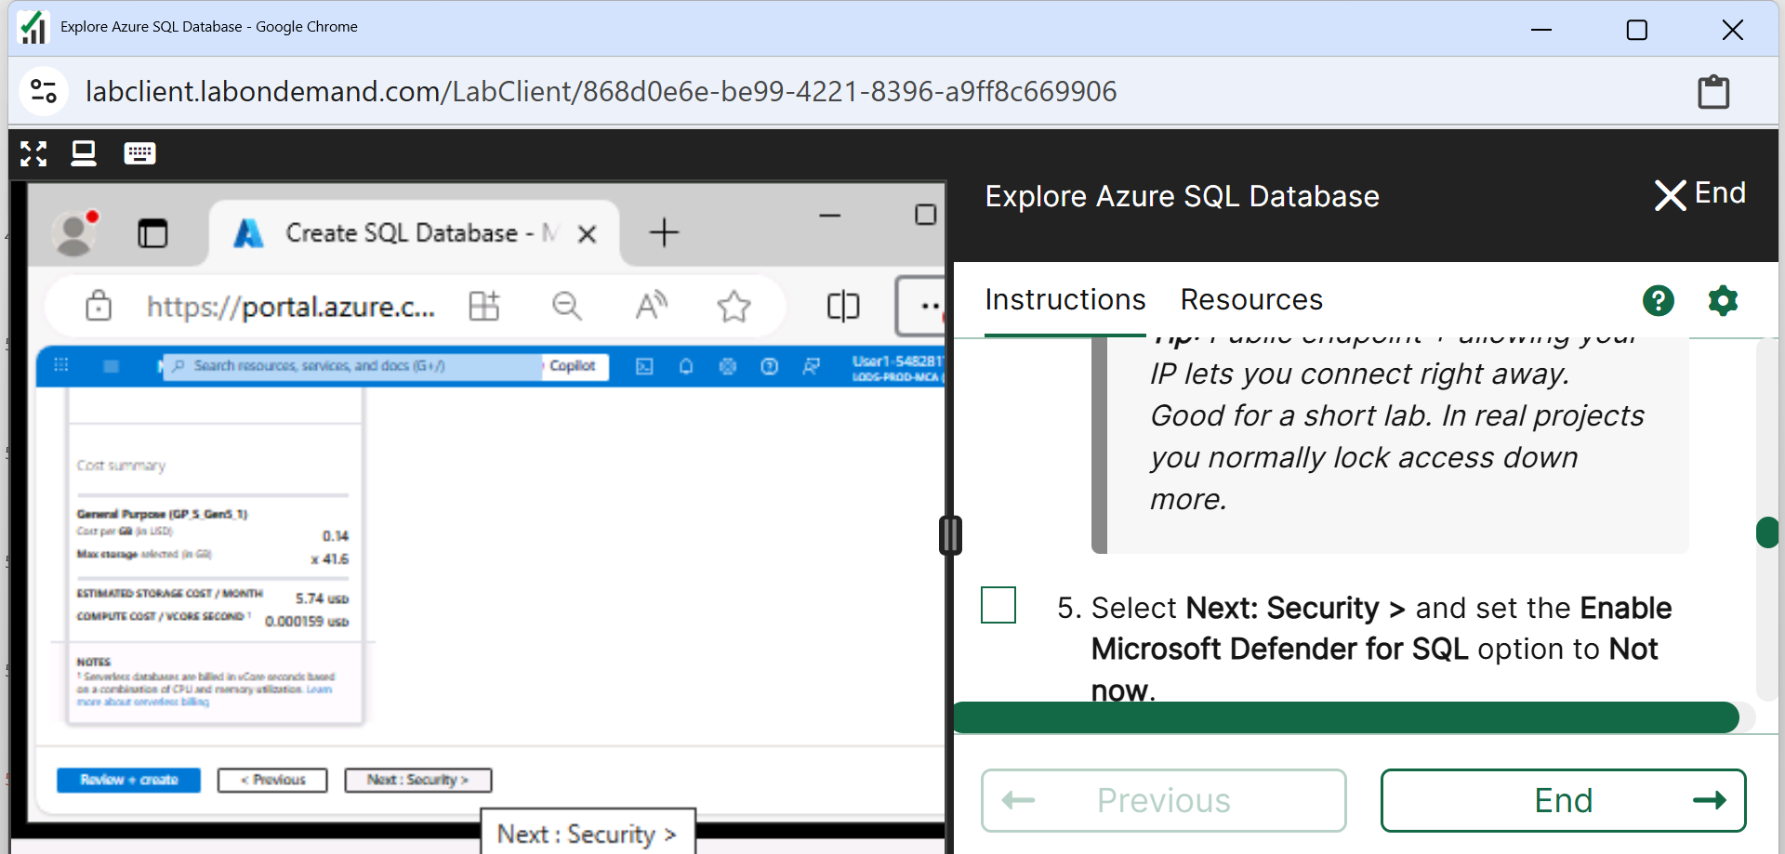
Week 8 Tutorial Activity (Step-by-Step)
Click on Next: Security >

Slide 66
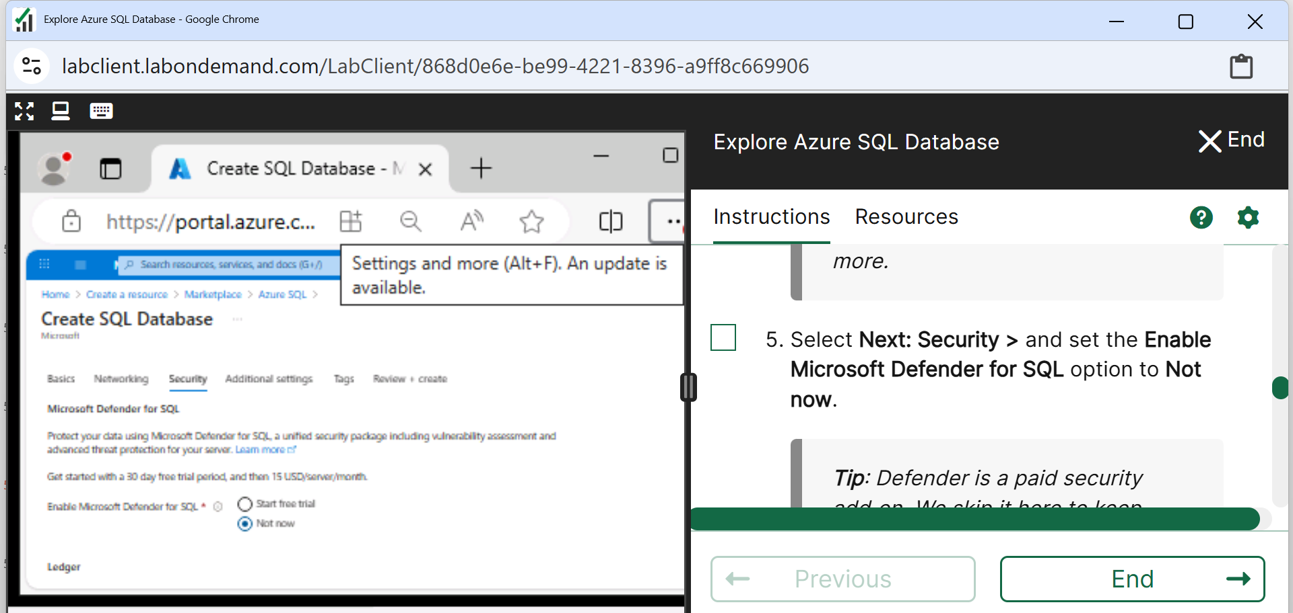
Week 8 Tutorial Activity (Step-by-Step)
Microsoft Defender: Not Now

Slide 67
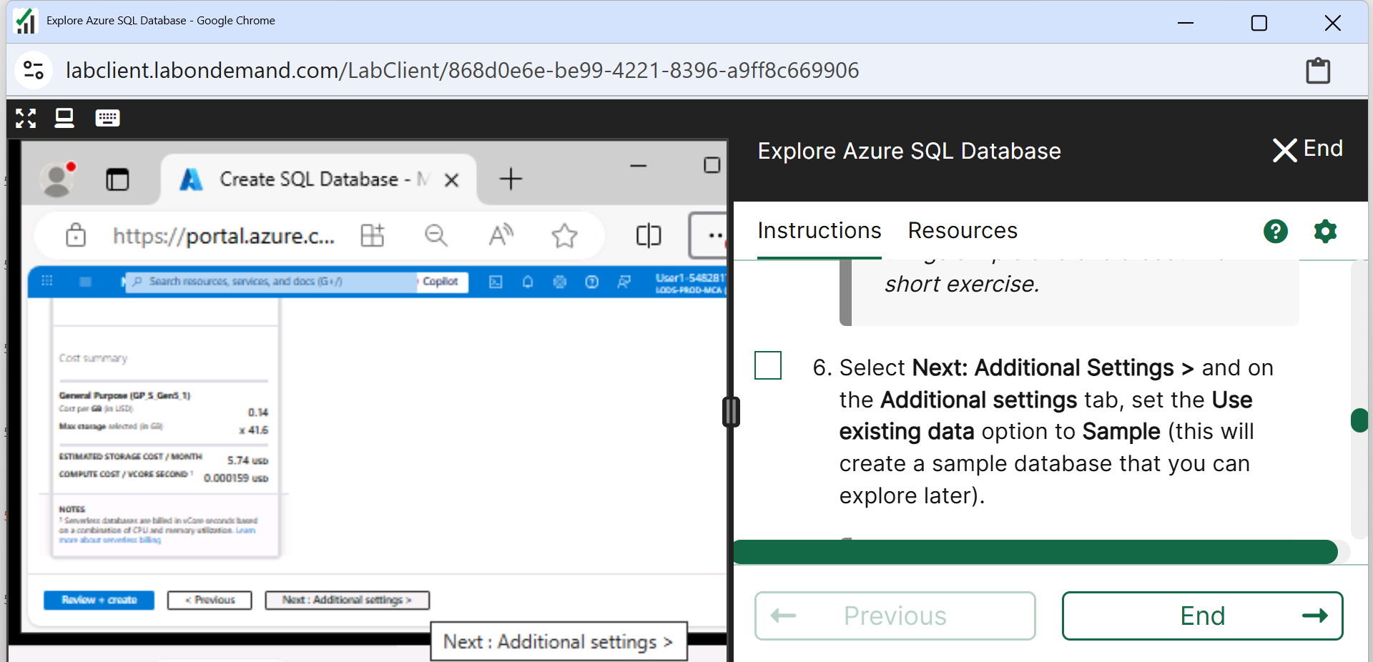
Week 8 Tutorial Activity (Step-by-Step)
Next: Additional Settings

Slide 68
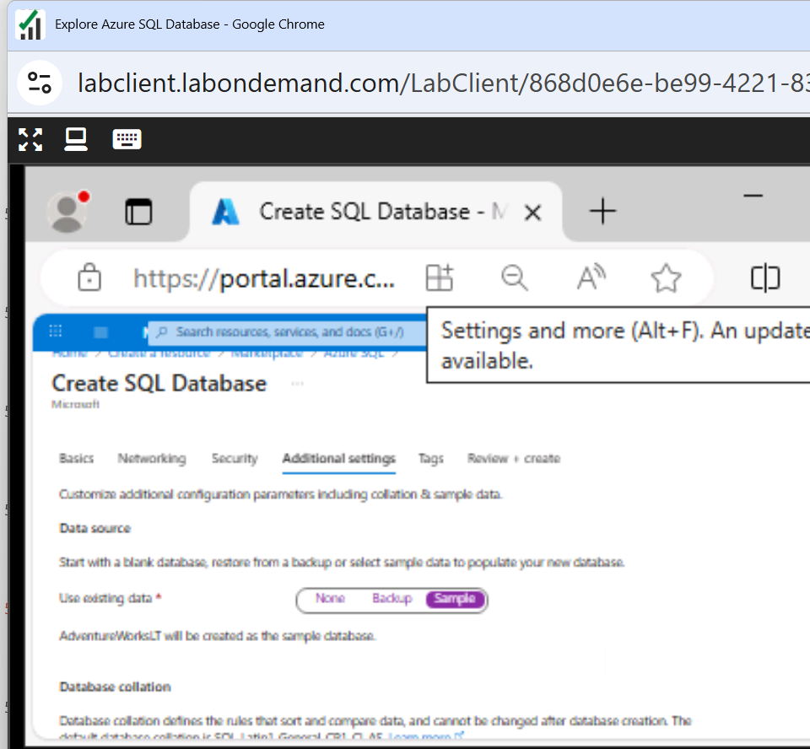
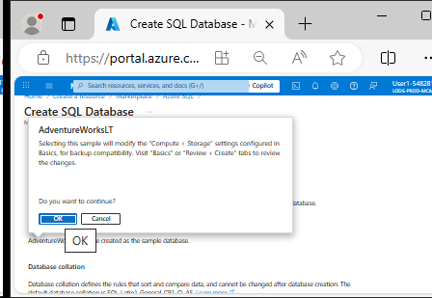
Week 8 Tutorial Activity (Step-by-Step)
Choose Sample

Slide 69
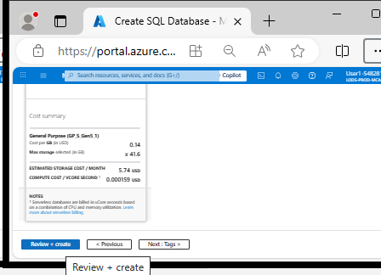
Week 8 Tutorial Activity (Step-by-Step)
Review and Create

Slide 70
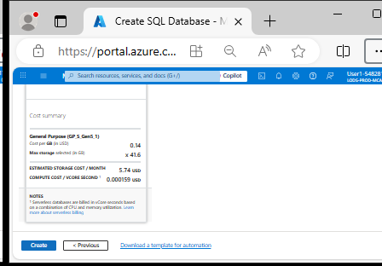
Week 8 Tutorial Activity (Step-by-Step)
Create

Slide 71
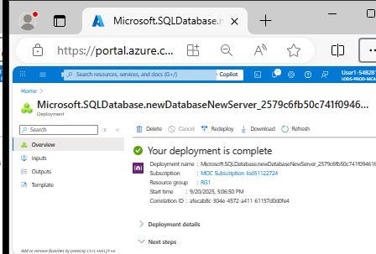
Week 8 Tutorial Activity (Step-by-Step)
Wait for deployment to complete

Slide 72
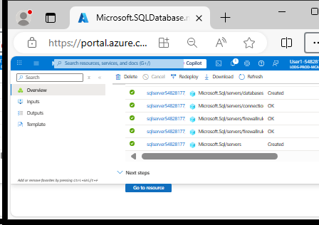
Week 8 Tutorial Activity (Step-by-Step)
Go to the Resource that was deployed

Slide 73
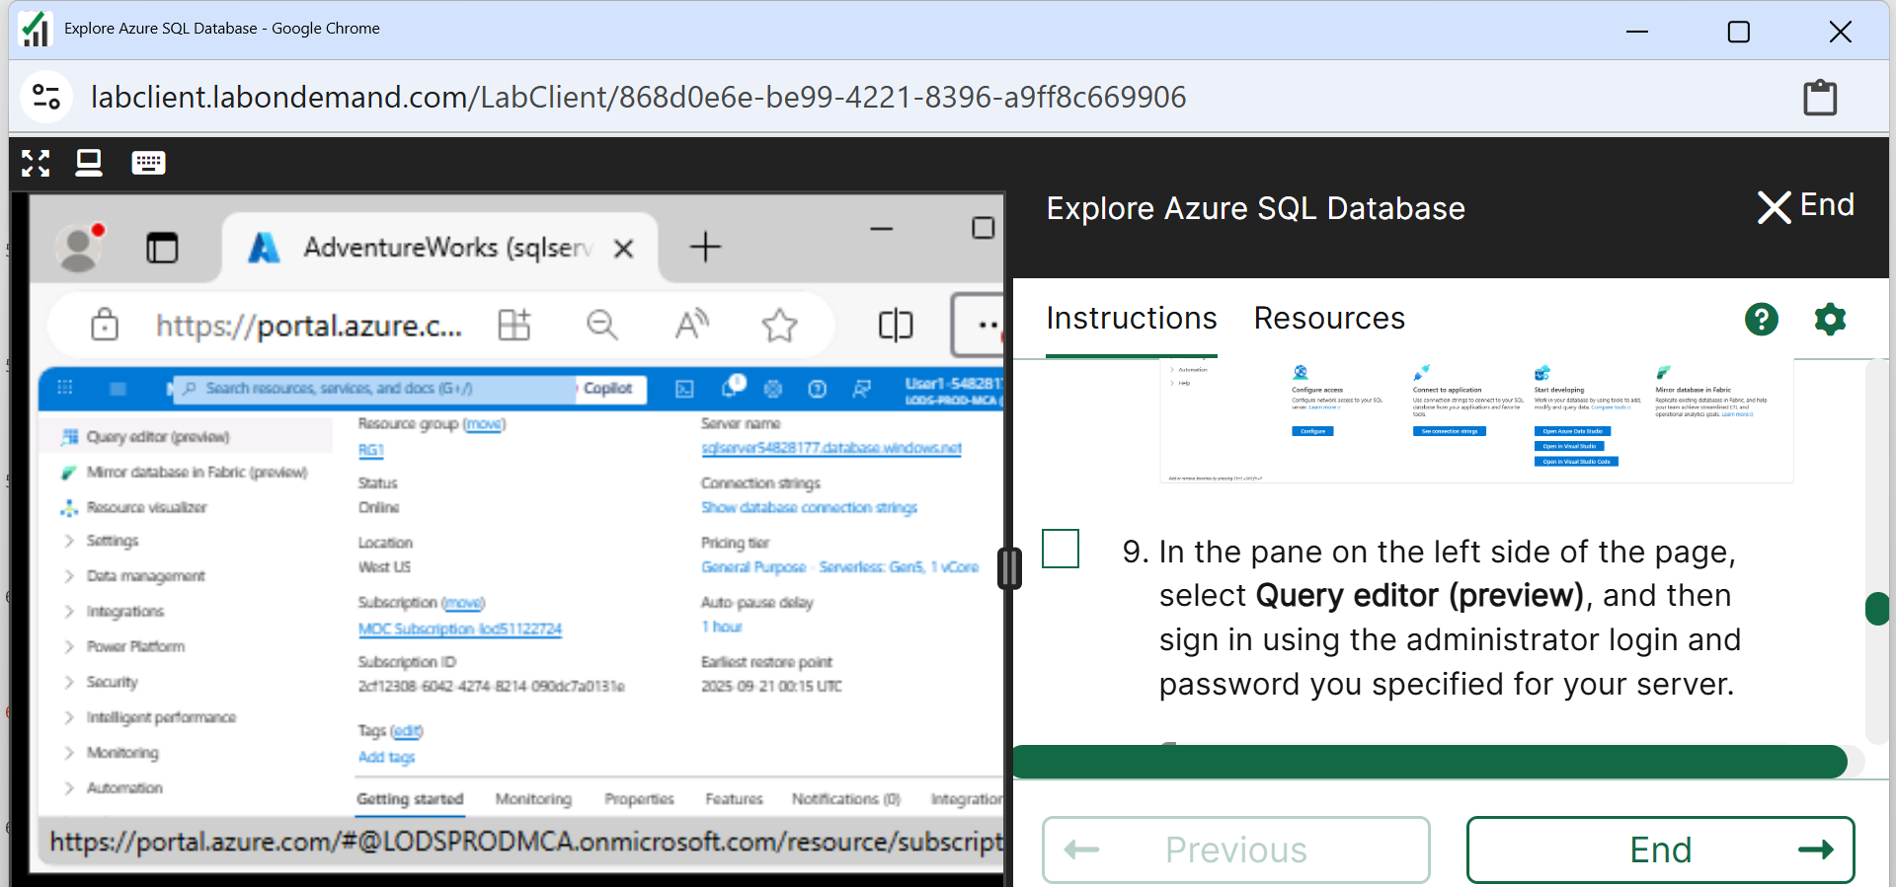
Week 8 Tutorial Activity (Step-by-Step)
Click on Query Editor

Slide 74
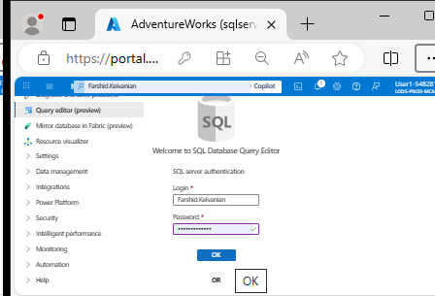
Week 8 Tutorial Activity (Step-by-Step)
Sign-in using administration log in

Slide 75
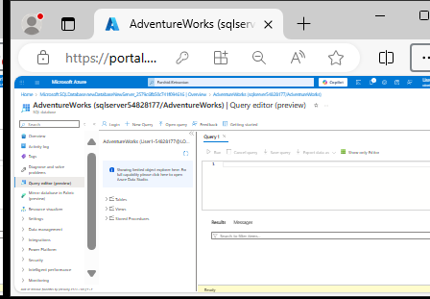
Week 8 Tutorial Activity (Step-by-Step)
Here is Query Editor

Slide 76
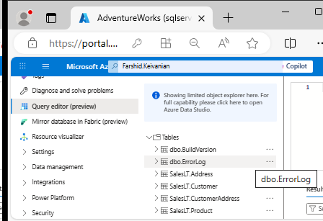
Week 8 Tutorial Activity (Step-by-Step)
Expand Tables

Slide 77
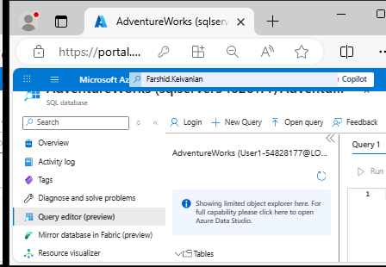
Week 8 Tutorial Activity (Step-by-Step)
Click on <<

Slide 78
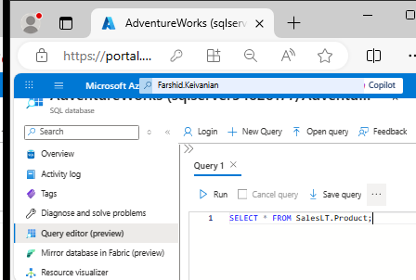
Week 8 Tutorial Activity (Step-by-Step)
Step 12 – Take a screenshot) In the Query 1, enter the following code: (Click on Type on right side panel)

Slide 79
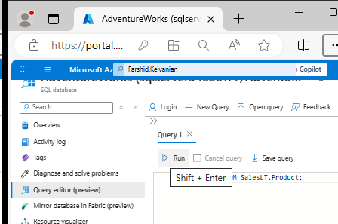
Week 8 Tutorial Activity (Step-by-Step)
Step 12 – Take a screenshot) Shift + Enter (Or click Run)

Slide 80
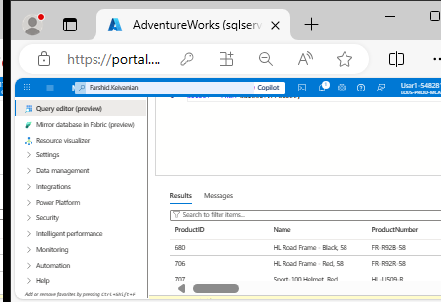
Week 8 Tutorial Activity (Step-by-Step)
Step 12 – Take a screenshot) It will show all columns for all rows

Slide 81


Week 8 Tutorial Activity (Step-by-Step)
Select All and remove

Slide 82

Week 8 Tutorial Activity (Step-by-Step)
Step 13 – Take a screenshot) Click on Type to enter this Query

Slide 83

Week 8 Tutorial Activity (Step-by-Step)
Step 13 – Take a screenshot) You will see the results

Slide 84

Week 8 Tutorial Activity (Step-by-Step)
Select all and remove them

Slide 85

Week 8 Tutorial Activity (Step-by-Step)
Step 14 – Take a screenshot) Click Type and Run

Slide 86
Week 8 Tutorial Activity (Step-by-Step)
Step 14 – Take a screenshot) Click Type and Run
SELECT
p.ProductID,
p.Name AS ProductName,
c.Name AS Category,
p.ListPrice
FROM SalesLT.Product AS p
INNER JOIN SalesLT.ProductCategory AS c
ON p.ProductCategoryID = c.ProductCategoryID;
What this query is doing
It is combining two tables to show product details along with their category names.

Slide 87
Week 8 Tutorial Activity (Step-by-Step)
Step 14 – Take a screenshot) Click Type and Run
The two tables involved
1. Product table (SalesLT.Product)
ProductID | Name | ProductCategoryID | ListPrice
1 | Bike | 10 | 500
2 | Helmet | 20 | 50
3 | Gloves | 20 | 25

Slide 88
Week 8 Tutorial Activity (Step-by-Step)
Step 14 – Take a screenshot) Click Type and Run
2. Category table (SalesLT.ProductCategory)
ProductCategoryID | Name
10 | Vehicles
20 | Accessories

Slide 89
Week 8 Tutorial Activity (Step-by-Step)
Step 14 – Take a screenshot) Click Type and Run
What INNER JOIN does
It matches rows from both tables where:
p.ProductCategoryID = c.ProductCategoryID
In simple words:
Find the category ID in the Product table
Match it with the same ID in the Category table
Combine the information into one row

Slide 90
Week 8 Tutorial Activity (Step-by-Step)
Step 14 – Take a screenshot) Click Type and Run
SELECT
p.ProductID,
p.Name AS ProductName,
c.Name AS Category,
p.ListPrice
FROM SalesLT.Product AS p
INNER JOIN SalesLT.ProductCategory AS c
ON p.ProductCategoryID = c.ProductCategoryID;
Choose these columns:
Product ID
Product name (renamed as ProductName)
Category name (from the other table)
Price

Slide 91
Week 8 Tutorial Activity (Step-by-Step)
Step 14 – Take a screenshot) Click Type and Run
SELECT
p.ProductID,
p.Name AS ProductName,
c.Name AS Category,
p.ListPrice
FROM SalesLT.Product AS p
INNER JOIN SalesLT.ProductCategory AS c
ON p.ProductCategoryID = c.ProductCategoryID;
We are asking the database to show these columns:
p.ProductID → the product’s ID number
p.Name AS ProductName → the product’s name (renamed to ProductName so it’s clearer)
c.Name AS Category → the category name (renamed to Category)
p.ListPrice → the product’s price

Slide 92
Week 8 Tutorial Activity (Step-by-Step)
SELECT
p.ProductID,
p.Name AS ProductName,
c.Name AS Category,
p.ListPrice
FROM SalesLT.Product AS p
INNER JOIN SalesLT.ProductCategory AS c
ON p.ProductCategoryID = c.ProductCategoryID;
Start with the Product table Give it a short name p (alias)
Look in the Product table (short name = p).

Slide 93
Week 8 Tutorial Activity (Step-by-Step)
SELECT
p.ProductID,
p.Name AS ProductName,
c.Name AS Category,
p.ListPrice
FROM SalesLT.Product AS p
INNER JOIN SalesLT.ProductCategory AS c
ON p.ProductCategoryID = c.ProductCategoryID;
Bring in the Category table Give it alias c

Slide 94
Week 8 Tutorial Activity (Step-by-Step)
SELECT
p.ProductID,
p.Name AS ProductName,
c.Name AS Category,
p.ListPrice
FROM SalesLT.Product AS p
INNER JOIN SalesLT.ProductCategory AS c
ON p.ProductCategoryID = c.ProductCategoryID;
Match rows where both tables have the same category ID

Slide 95
Week 8 Tutorial Activity (Step-by-Step)
SELECT
p.ProductID,
p.Name AS ProductName,
c.Name AS Category,
p.ListPrice
FROM SalesLT.Product AS p
INNER JOIN SalesLT.ProductCategory AS c
ON p.ProductCategoryID = c.ProductCategoryID;
Combine the Product table (p) with the ProductCategory table (c).
INNER JOIN means: only show rows where the ProductCategoryID matches in both tables.
This lets us see each product together with its category name.

Slide 96
Week 8 Tutorial Activity (Step-by-Step)
SELECT
p.ProductID,
p.Name AS ProductName,
c.Name AS Category,
p.ListPrice
FROM SalesLT.Product AS p
INNER JOIN SalesLT.ProductCategory AS c
ON p.ProductCategoryID = c.ProductCategoryID;
In summary, show me each product, its price, and the name of its category by matching the category IDs from both tables.

Slide 97

Week 8 Tutorial Activity (Step-by-Step)
New Query

Slide 98

Week 8 Tutorial Activity (Step-by-Step)
Query 1: Write a new query to retrieve the CustomerID, Title, last name, and Company Name of Customers whose Customer ID is in the following list: ( 1, 3, 5, 20, 45), sorted by Customer last name in reverse alphabetical order.

Slide 99
Week 8 Tutorial Activity (Step-by-Step)
Query 1 – Take a screenshot) Type this
SELECT CustomerID, Title, LastName, CompanyName
FROM SalesLT.Customer
WHERE CustomerID IN (1, 3, 5, 20, 45)
ORDER BY LastName DESC;
SELECT
Choose these columns:
CustomerID
Title
LastName
CompanyName

Slide 100
Week 8 Tutorial Activity (Step-by-Step)
Query 1 – Take a screenshot) Type this
SELECT CustomerID, Title, LastName, CompanyName
FROM SalesLT.Customer
WHERE CustomerID IN (1, 3, 5, 20, 45)
ORDER BY LastName DESC;
WHERE CustomerID IN (1, 3, 5, 20, 45)
This means:
Only include customers with these IDs
Ignore all others

Slide 101
Week 8 Tutorial Activity (Step-by-Step)
Query 1 – Take a screenshot) Type this
SELECT CustomerID, Title, LastName, CompanyName
FROM SalesLT.Customer
WHERE CustomerID IN (1, 3, 5, 20, 45)
ORDER BY LastName DESC;
Selected rows with CustomerID: 1, 3, 5, 20, 45
ORDER BY LastName DESC;
Sort by LastName
DESC = descending (Z → A)

Slide 102
Week 8 Tutorial Activity (Step-by-Step)
Query 1 – Take a screenshot) Type this
SELECT CustomerID, Title, LastName, CompanyName
FROM SalesLT.Customer
WHERE CustomerID IN (1, 3, 5, 20, 45)
ORDER BY LastName DESC;
In summary, show specific customers (IDs 1, 3, 5, 20, 45) and sort them by last name in reverse alphabetical order.

Slide 103

Week 8 Tutorial Activity (Step-by-Step)
Query 1 – Take a screenshot) Run and See the results

Slide 104
Week 8 Tutorial Activity (Step-by-Step)
Query 2: Write a new query to retrieve a list of sales order revisions
The SalesLT.SalesOrderHeader table contains records of sales orders. You have been asked to retrieve data for a report that shows:
The sales order number and revision number in the format () – for example, SO71774 (2).
The order date converted to ANSI standard 102 format (yyyy.mm.dd – for example, 2015.01.31).
Hint: Use the STR function to convert the number data type to String.
Take a screenshot showing both the SQL code of the query and its results.

Slide 105

Week 8 Tutorial Activity (Step-by-Step)
SELECT
SalesOrderNumber + ' (' + STR(RevisionNumber) + ')' AS Order_Revision,
CONVERT(varchar(10), OrderDate, 102) AS OrderDate_YYYYMMDD
FROM SalesLT.SalesOrderHeader;

Slide 106
Week 8 Tutorial Activity (Step-by-Step)
SELECT
SalesOrderNumber + ' (' + STR(RevisionNumber) + ')' AS Order_Revision,
CONVERT(varchar(10), OrderDate, 102) AS OrderDate_YYYYMMDD
FROM SalesLT.SalesOrderHeader;
What this query does
It:
Combines order number + revision number into one column
Formats the date into a specific style (YYYY.MM.DD)

Slide 107
Week 8 Tutorial Activity (Step-by-Step)
SELECT
SalesOrderNumber + ' (' + STR(RevisionNumber) + ')' AS Order_Revision,
CONVERT(varchar(10), OrderDate, 102) AS OrderDate_YYYYMMDD
FROM SalesLT.SalesOrderHeader;
Step 1: Creating Order + Revision
SalesOrderNumber + ' (' + STR(RevisionNumber) + ')' AS Order_Revision
What’s happening:
Take SalesOrderNumber → e.g. SO123
Add " ("

Slide 108
Week 8 Tutorial Activity (Step-by-Step)
SELECT
SalesOrderNumber + ' (' + STR(RevisionNumber) + ')' AS Order_Revision,
CONVERT(varchar(10), OrderDate, 102) AS OrderDate_YYYYMMDD
FROM SalesLT.SalesOrderHeader;
Convert RevisionNumber (number → text) using STR()
Add ")"

Slide 109
Week 8 Tutorial Activity (Step-by-Step)
SELECT
SalesOrderNumber + ' (' + STR(RevisionNumber) + ')' AS Order_Revision,
CONVERT(varchar(10), OrderDate, 102) AS OrderDate_YYYYMMDD
FROM SalesLT.SalesOrderHeader;
Step 2: Formatting the date
CONVERT(varchar(10), OrderDate, 102) AS OrderDate_YYYYMMDD
This means:
Convert the date into text (varchar)
Use format 102

Slide 110
Week 8 Tutorial Activity (Step-by-Step)
SELECT
SalesOrderNumber + ' (' + STR(RevisionNumber) + ')' AS Order_Revision,
CONVERT(varchar(10), OrderDate, 102) AS OrderDate_YYYYMMDD
FROM SalesLT.SalesOrderHeader;
Format 102 = YYYY.MM.DD
Example:
2026-04-20 → 2026.04.20

Slide 111
Week 8 Tutorial Activity (Step-by-Step)
SELECT
SalesOrderNumber + ' (' + STR(RevisionNumber) + ')' AS Order_Revision,
CONVERT(varchar(10), OrderDate, 102) AS OrderDate_YYYYMMDD
FROM SalesLT.SalesOrderHeader;
First column
Join order number and revision number into one string
Second column
Change the date into a readable text format (YYYY.MM.DD)
FROM
Get data from the SalesOrderHeader table

Slide 112
Week 8 Tutorial Activity (Step-by-Step)
SELECT
SalesOrderNumber + ' (' + STR(RevisionNumber) + ')' AS Order_Revision,
CONVERT(varchar(10), OrderDate, 102) AS OrderDate_YYYYMMDD
FROM SalesLT.SalesOrderHeader;
In summary, show each order as ‘OrderNumber (Revision)’ and display the date in YYYY.MM.DD format.

Slide 113
Week 8 Tutorial Activity (Step-by-Step)
SELECT
SalesOrderNumber + ' (' + STR(RevisionNumber) + ')' AS Order_Revision,
CONVERT(varchar(10), OrderDate, 102) AS OrderDate_YYYYMMDD
FROM SalesLT.SalesOrderHeader;
SalesOrderNumber + ' (' + STR(RevisionNumber) + ')':
Joins the order number with the revision number.
Example: SO71774 (2).
STR() changes the RevisionNumber (a number) into text so it can be joined.
Renamed as Order_Revision.

Slide 114
Week 8 Tutorial Activity (Step-by-Step)
SELECT
SalesOrderNumber + ' (' + STR(RevisionNumber) + ')' AS Order_Revision,
CONVERT(varchar(10), OrderDate, 102) AS OrderDate_YYYYMMDD
FROM SalesLT.SalesOrderHeader;
CONVERT(varchar(10), OrderDate, 102):
Converts the date into the format yyyy.mm.dd.
Example: 2015.01.31.
Renamed as OrderDate_YYYYMMDD.

Slide 115
Week 8 Tutorial Activity (Step-by-Step)
SELECT
SalesOrderNumber + ' (' + STR(RevisionNumber) + ')' AS Order_Revision,
CONVERT(varchar(10), OrderDate, 102) AS OrderDate_YYYYMMDD
FROM SalesLT.SalesOrderHeader;
FROM SalesLT.SalesOrderHeader:
Tells SQL to pull the data from the SalesLT.SalesOrderHeader table.

Slide 116

Week 8 Tutorial Activity (Step-by-Step)
The result should be two columns:
_YYYYMOrder_Revision (e.g., SO71774 (2))
OrderDateMDD (e.g., 2015.01.31)

Slide 117

Week 8 Tutorial Activity (Step-by-Step)
Query 3: Write a new query to retrieve the top 10 most expensive products in the database.

Slide 118
Week 8 Tutorial Activity (Step-by-Step)
Query 3 – Take a screenshot: Write a new query to retrieve the top 10 most expensive products in the database.
What this query does
It shows the 10 most expensive products (that actually have a price).
SELECT TOP (10)
ProductID,
Name,
ListPrice
FROM SalesLT.Product
WHERE ListPrice IS NOT NULL
ORDER BY ListPrice DESC;

Slide 119
Week 8 Tutorial Activity (Step-by-Step)
Query 3 – Take a screenshot: Write a new query to retrieve the top 10 most expensive products in the database.
Step 1: WHERE clause
WHERE ListPrice IS NOT NULL
This means:
Ignore products with no price (NULL)
Only keep products that have a price
SELECT TOP (10)
ProductID,
Name,
ListPrice
FROM SalesLT.Product
WHERE ListPrice IS NOT NULL
ORDER BY ListPrice DESC;

Slide 120
Week 8 Tutorial Activity (Step-by-Step)
Query 3 – Take a screenshot: Write a new query to retrieve the top 10 most expensive products in the database.
Step 2: ORDER BY
ORDER BY ListPrice DESC;
Sort by price:
DESC = highest → lowest
SELECT TOP (10)
ProductID,
Name,
ListPrice
FROM SalesLT.Product
WHERE ListPrice IS NOT NULL
ORDER BY ListPrice DESC;

Slide 121
Week 8 Tutorial Activity (Step-by-Step)
Query 3 – Take a screenshot: Write a new query to retrieve the top 10 most expensive products in the database.
Step 3: TOP (10)
SELECT TOP (10)
Only show the first 10 rows
Since we sorted highest first, this gives:
Top 10 most expensive products
SELECT TOP (10)
ProductID,
Name,
ListPrice
FROM SalesLT.Product
WHERE ListPrice IS NOT NULL
ORDER BY ListPrice DESC;

Slide 122
Week 8 Tutorial Activity (Step-by-Step)
Query 3 – Take a screenshot: Write a new query to retrieve the top 10 most expensive products in the database.
SELECT TOP (10)
Only show the first 10 results
WHERE
Ignore products with no price
ORDER BY DESC
Sort from most expensive to cheapest
One-line summary
Show the 10 most expensive products that have a price.
SELECT TOP (10)
ProductID,
Name,
ListPrice
FROM SalesLT.Product
WHERE ListPrice IS NOT NULL
ORDER BY ListPrice DESC;

Slide 123

Week 8 Tutorial Activity (Step-by-Step)
The results lists the 10 most expensive products in the database, starting with the highest price at the top. (Take a screenshot)

Slide 124
Week 8 Tutorial Activity (Step-by-Step)
Submit
Paste the screenshots of completing steps 12, 13 and 14, Query 1, Query 2, and Query 3 (6 screenshots) in a single Word/pdf file and submit using the assignment module 8 submission link. The screenshots must show both the SQL code of the query and its results.

Slide 125
Week 8 Tutorial Activity (Step-by-Step)
Quick fixes (common issues)
“Customers table not found” → Use the right name: SalesLT.Customer (not Customers)
Login fails in Query editor → Add your client IP in Networking
No sample tables → You likely missed AdventureWorksLT; use SELECT 1; or create a simple table to test

Slide 126
Week 8 Tutorial Activity (Step-by-Step)
What the answers should show (in words)
Q1: Only those 5 CustomerIDs, sorted by LastName descending
Q2: Orders with their RevisionNumber (and a neat date), or a count per revision
Q3: The 10 highest ListPrice products, from most to less expensive

Slide 127
Review & Reflection
What did we learn?
Difference: Access vs Azure SQL.
Provision DBs in the cloud.
Write SQL queries.
Why important?
Skills → Azure Fundamentals Certification.
Real jobs in data engineering, DB admin.

Slide 128
Discussion & Role-Play Questions
Q: Why can’t Woolworths or Qantas run their operations on MS Access?
A: Access can’t handle thousands of concurrent users & terabytes of data.
Q: Debate: Should Australian universities keep data on campus servers or move to Azure Cloud?
For: Cloud = secure, scalable, cheaper long-term. Against: Privacy risks, ongoing cost, internet dependency.

Slide 129
Discussion & Role-Play Questions
Q: If Azure SQL is PaaS, what control do we lose vs IaaS?
A: We lose full control of the server (patching, OS-level settings).

Slide 130
Thank You
Have a Great Learning Day!
Feel free to reach out with any questions!
Dr. Farshid Keivanian

